Slide 1



Institute of Information and Communication Technology
Khulna University of Engineering & Technology, Khulna
A Systematic Review on Federated Learning in Medical Image Analysis
By Sohan & Basalamah (2023)
Presented By
Name: Joy Kumar Dey
ID: 2671506
Course Code: ICT 6513
Course Title: Artificial Intelligence in Healthcare

Slide 2

Outline
Problem Statement
Taxonomy
Security & Privacy
Open Challenges
Critical Analysis
Key Takeaways
Primary References
Conclusion
1

Slide 3
Problem Statement
Lung Disease Detection Challenges
The paper addresses the challenge of detecting lung diseases (tuberculosis, pneumonia, COVID-19, lung cancer) using chest X-ray images. Key problems:
Data fragmentation across hospitals
Privacy concerns with centralized data sharing
Need for accurate, generalizable models across diverse patient populations
Limited labeled data at individual sites
2

Slide 4
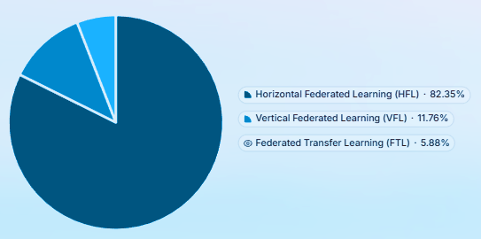
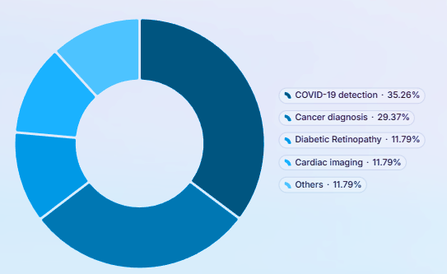
Taxonomy
Categorization of Approaches (across 95 reviewed studies)
Distribution of Federated Learning Approaches
Disease Application Distribution
3

Slide 5
Security & Privacy
Data Protection in Federated Learning based Medical Imaging
1) Federated Learning baseline
2) Differential Privacy (DP)
Raw patient data never leaves the hospital; only model weights or gradients are shared .
Noise is added to model updates to reduce the risk of gradient inversion attacks.
3) Secure Aggregation (SecAgg)
4) Blockchain + Encryption
Cryptography ensures the server only sees aggregated updates, not individual client contributions.
Blockchain-based data management with encryption and unique patient IDs was used by Połap et al.
4

Slide 6
Open Challenges
Unsolved Problems in FL for Medical Image Analysis
1) Non-IID data distribution
2) Data heterogeneity
Hospitals differ in disease prevalence and imaging protocols.
Client data can vary by modality and feature space.
3) Model performance gap
4) Communication overhead
FL models often underperform traditional ML approaches.
Training large CNNs requires substantial bandwidth.
5) Lack of standardized benchmarks
6) Privacy concerns not fully solved
No common FL benchmark exists for medical imaging.
Reverse engineering risks still remain.
5

Slide 7
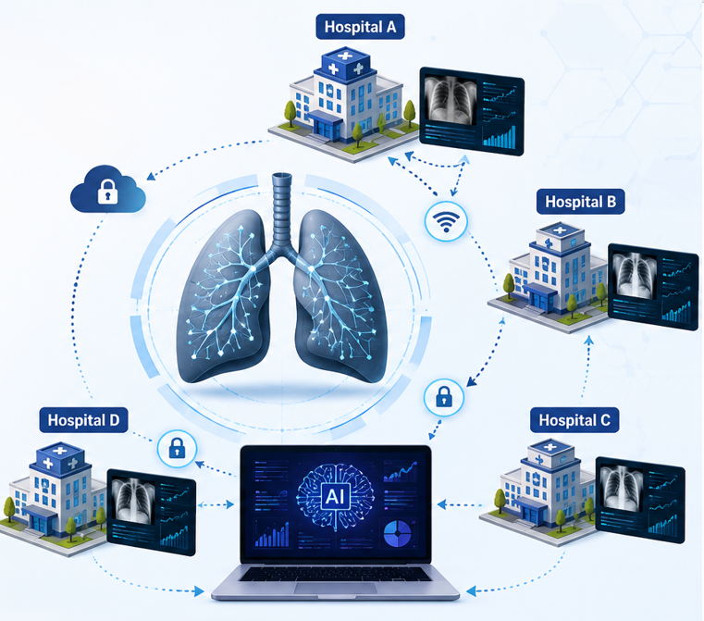
Critical Analysis
Limitations and Missing Perspectives
Personal assessment of the paper's limitations:
1
Limited real-world validation
2
Scalability questions
3
Missing fairness analysis
Mostly tested on public datasets rather than real multi-hospital networks.
It is unclear how FL performs beyond small 2-4 client setups.
Bias across race, gender, and socioeconomic status is largely unaddressed.
4
Lack of explainability
5
No clinical deployment
Few papers include XAI, limiting clinician trust and interpretation.
None of the papers report FDA/CE approval or real-world deployment.
6

Slide 8
Key Takeaways
1
Federated Learning is validated as a privacy-preserving approach for medical image analysis.
2
Horizontal FL (HFL) dominates with 14/17 papers; most common in COVID-19 detection (35.3%) and cancer diagnosis (29.4%).
3
Multiple privacy mechanisms exist: FL baseline, Differential Privacy, Secure Aggregation, and Blockchain encryption.
4
Critical gap: FL models underperform traditional ML in accuracy but offer superior privacy protection.
5
Standardization needed: No benchmark FL model or dataset exists for medical imaging research.
6
Real-world deployment remains absent: Zero papers report FDA/CE approval or clinical deployment.
7

Slide 9
Primary References
Key papers reviewed in the systematic review:
Sohan, M. F., & Basalamah, A. (2023). "A Systematic Review on Federated Learning in Medical Image Analysis." IEEE Access, Vol. 11, pp. 28628-28644. DOI: 10.1109/ACCESS.2023.3260027
Note: A comprehensive reference table containing most of the key references among 95+ references cited within the Sohan & Basalamah (2023) paper is provided separately as a one-page PDF summary, covering all reviewed articles on FL in medical imaging.
8

Slide 10




Conclusion
Key Takeaways and Future Directions
1
FL is a promising privacy-preserving paradigm for collaborative medical AI, but real-world clinical deployment remains absent.
Privacy-utility tradeoff must be better quantified and optimized to make FL competitive with centralized approaches.
2
3
Regulatory pathways (FDA/CE Mark) for federated systems must be established
to enable clinical adoption.
4
Multi-modal FL (imaging + genomics + wearables) represents an important frontier for comprehensive patient care.
9

Slide 11
Thank you
Any Questions?
10

